Slide 1
Unirep update: Predicting new clones
8/17/2020
Emily Makowski + Patrick Kinnunen

Slide 2
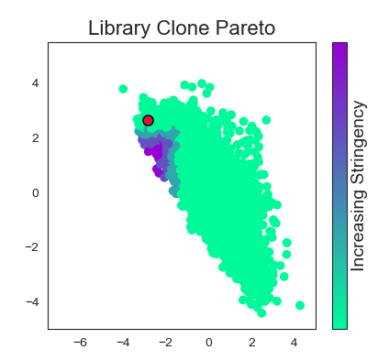
Process flow chart – Pareto optmization
Analog data from isolated clones
Functionalizing LDA
LDA on unirep features
Pareto curve for features
Unirep representations
NGS data from screen/sort

Slide 3
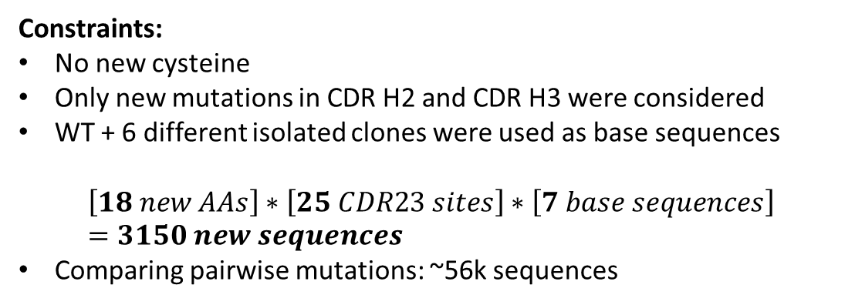
Next steps: Proposing new clones
Simplest way: start from some of the best isolated sequences, and try all possible single mutations
Computationally tractable, fits with Emily’s leave-one-out analysis
LHQWY… Base sequence
BHQWY… Mutation 1 at site 1
CHQWY…
…
LAQWY… Mutation 1 at site 2
LBQWY…
…
LBQWV… Mutation 19 at site N
Constraints:
No new cysteine
Only new mutations in CDR H2 and CDR H3 were considered
WT + 6 different isolated clones were used as base sequences
$$\left[18 new AAs\right]∗\left[25 CDR23 sites\right]∗\left[7 base sequences\right]=3150 new sequences$$
Comparing pairwise mutations: ~56k sequences

Slide 4
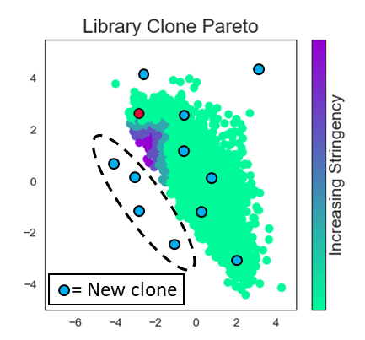
Comparing new and old clones
LHQWY… Base sequence
BHQWY… Mutation 1 at site 1
CHQWY…
…
LAQWY… Mutation 1 at site 2
LBQWY…
…
LBQWV… Mutation 19 at site N
With hypothetical new clones
Good new clones
Get ~3500 unirep representations

Slide 5
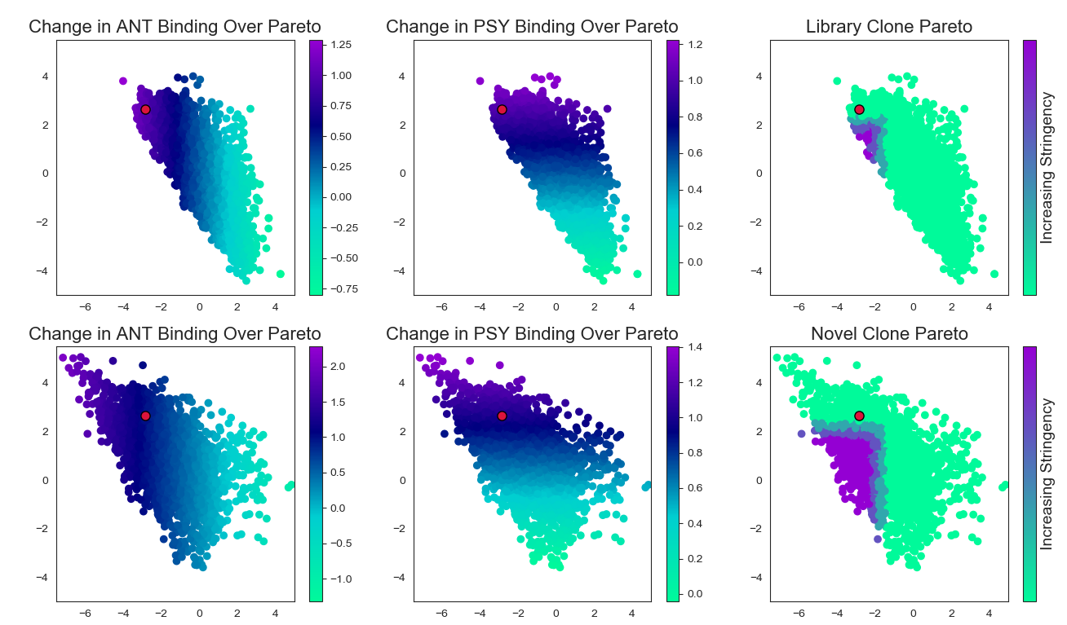
Proposed clones move the pareto front
By picking new mutations, we get many different clones that are past the original pareto front
Old pareto front

Slide 6
Emily add analysis of better clones

Slide 7
Process flow chart – Pareto optmization
Propose new mutations
Unirep Representations
Analog data from isolated clones
Functionalizing LDA
Analyze suggested “good” new clones
New suggested mutations/sites
LDA on unirep features
Pareto curve for features
Plot new mutations on pareto curve
Unirep representations
NGS data from screen/sort
Good new clones
= New clone

Slide 8
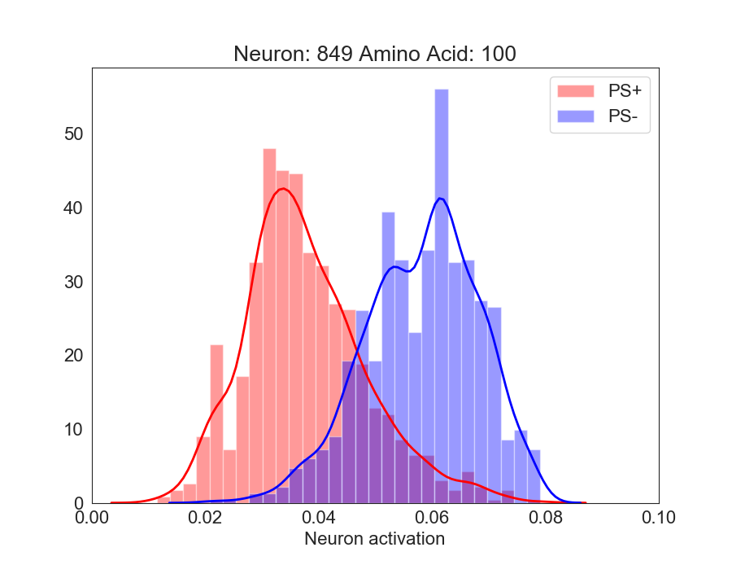
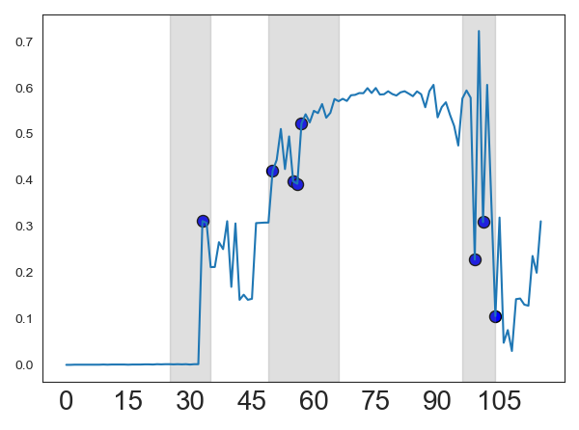
Process flow chart – Feature analysis
Compare distributions for best nodes at each position
NGS data from screen/sort
Identify best nodes
Unirep full representations

Slide 9
Emily add picking out new regions/mutation sites

Slide 10
Process flow chart – Feature analysis
Compare distributions for best nodes at each position
Find new amino acids with high differentiation between classes
New suggested mutations/sites
NGS data from screen/sort
Identify best nodes
Unirep full representations

Slide 11
How do they work together?
Analog data from isolated clones
New suggested mutations/sites
Pareto Optimization
Do the suggested mutations and sites match for each set of analysis?
NGS data from screen/sort
New suggested mutations/sites
Feature analysis

Slide 12
New sites from each method are in agreement
Emily add the combined analysis

Slide 13
Bonus info!

Slide 14
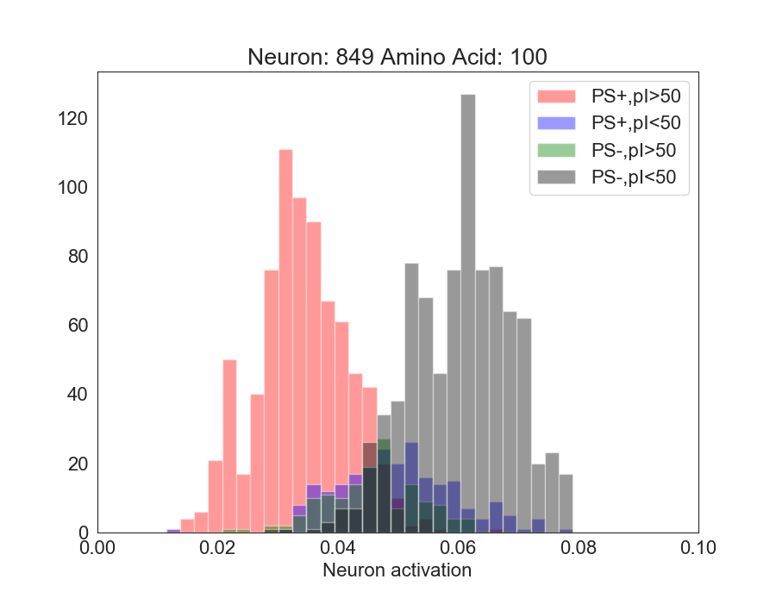
Segregating features by biophysical property
Distribution of sequences that emerges from unirep features analysis. Each sequence also has a set of biophysical descriptors
If we know both the neuron activation for a new sequence, and the sequence pI, we can be even more confident in our prediction of PS+ vs PS-.

Slide 15
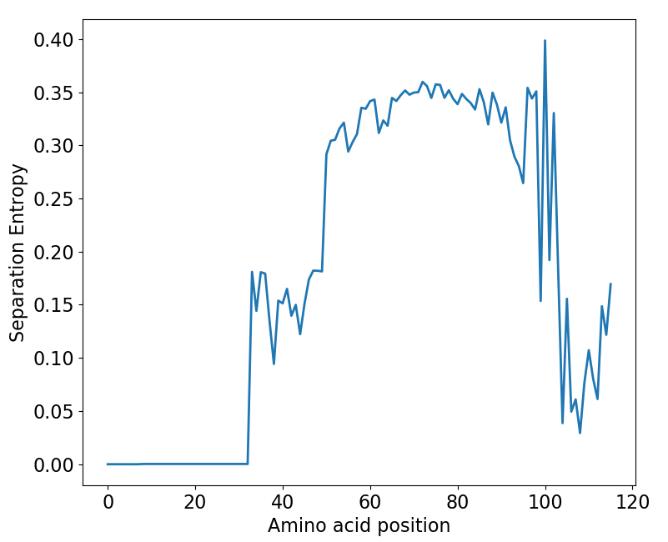
Process flow chart – Feature analysis
Segregate distributions by Biophysical properties
Compare distributions for best nodes at each position
New suggested mutations/sites
NGS data from screen/sort
Identify best nodes
Unirep full representations
Find new amino acids with high differentiation between classes

